Slide 1
Topic 14
Tree (Part II)
資料結構與程式設計
Data Structure and Programming
01/02/ 2019

Slide 2
What we have learned in “Tree Part I”...
Definitions and properties of Tree
Tree implementation
Tree traversal
Binary tree (BT)
  Complete/Full binary tree
Binary search tree (BST)
Balanced binary search tree (BBST)
  AVL

Slide 3
In “Tree Part II”…
We will cover more types of BBST
  Red-Black Tree
  B-Tree
    2-3 Tree
    2-3-4 Tree
  Splay Tree

Slide 4
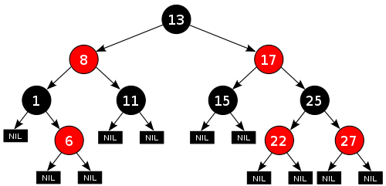
RB Tree
– Definition
A red-black tree is
a binary search tree
with the following
properties
A node is either red or black.
The root is black
All leaves are black (i.e. All leaves are same color as the root.)
Every red node must have two black child nodes.
Every path from a given node to any of its descendant leaves contains the same number of black nodes.

Slide 5
RB Tree
– Properties
Height-balanced:
  The path from the root to the farthest leaf is no more than twice as long as the path from the root to the nearest leaf
  ➔ Proof?
  This ensures the worst case of insert, delete, find operations to be O(log n)

Slide 6
Insert() operation
(As in BST) First, insert to the proper leaf
  Replace the leaf (null node) with a red node with two null leaves.
Then, what happens to the 5 properties in p4?
  1 ~ 3 holds?
  4 (red has two black children)?
  5 (every path has same #blacks)?
// What if new node is root?

Slide 7
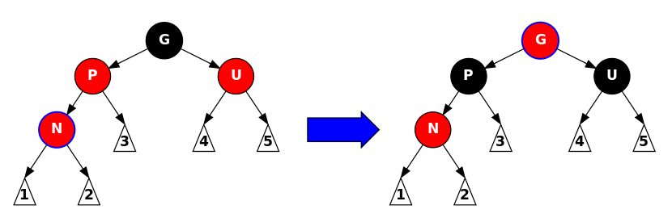
Insert() operation
Let N be the new node
If N is root ➔ change color
If N’s parent is black ➔ done
If both N’s parent and uncle are red
  Repaint parent (P) and uncle (U) to black
  Repaint grandparent (G) to red
  Let N = G, go to 1

Slide 8
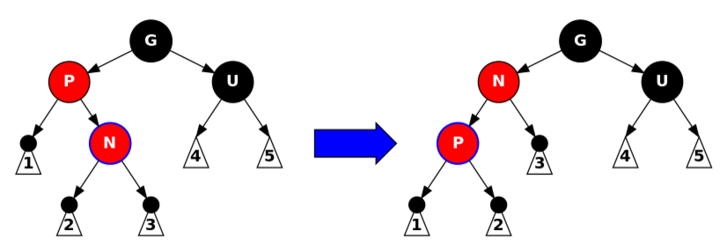
Insert() operation
If parent (P) is red, but uncle (U) is black, and N-P-G is zagged
  Perform a rotation to switch N and P
  Continue to 5

Slide 9
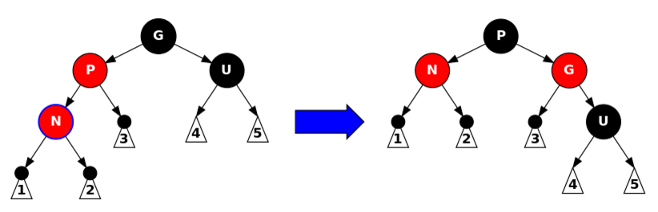
Insert() operation
If parent (P) is red, but uncle (U) is black, and N-P-G is in a line
  Perform a rotation to switch P and G
  Done!
  At most 2 rotations
  Complexity = O(h) = O(log n)

Slide 10
Delete() operation
Remember, we categorize the delete() of BST to 3 cases:
  Leaf case ➔ properties may be violated
  One-child case ➔ properties may be violated
  Two-children case
    Replaced N with its successor (replace value)
    Remove successor (becomes case 1 or 2 as successor must have at most one child)
  ➔ In the following, we focus on case 1 & 2

Slide 11
Delete() operation
Let D be the node to be deleted, and C be its selected child (i.e. the non-leaf child if D has one non-leaf child)
Simple case 1: D is red
  C must be black (property 4)
  C must be leaf (property 5)
  Just delete D and replace it with a leaf
Simple case 2: D is black and C is red
  C’s sibling must be black
  Delete D may violate properties 4 and 5
  ➔ Just replace D with C and repaint it black
D
C
D
C

Slide 12
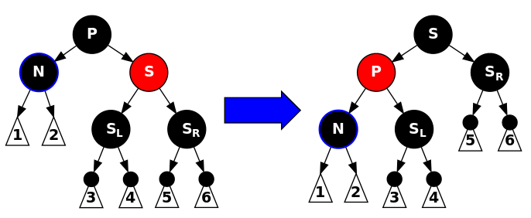
Delete() operation
The only complicate case is that both D and C are black
  C must be a leaf as N has at most one
  non-leaf child
  Let S be the sibling (if exists) of D
If D is root ➔ delete it; done.
If S is red
  Reverse the colors of D’s parent (P) and S
  Rotate P-S
  Deleting D will violate property 5 ➔ continue to step 4
D
C
D
D

Slide 13
Delete() operation
P
D
S
If S is black, P is black
  All the internal nodes
  between S and the leaves
  must be red.
  From property 4, there must
  be at most one red node
  between S and leaves.
  If both children of S are black,
  Both children must be leaves.
  Simply repaint S to red. Done!
  Otherwise (some child of S is red),
  go to 5 or 6.
P
S

Slide 14
Delete() operation
If S is black, P is red
  If any child of S is red, continue to 5 or 6.
  Otherwise (both children are leaves), just exchange the colors of P and S. done!
P
P
D
S
S

Slide 15
Delete() operation
If S is black, its left child S_{L} is red, right child is black (so it is a leaf), and D is the left child of P
  Rotate S_{L} – S, and continue to 6.
P
P
D
S
D
S_{L}
S_{L}
S

Slide 16
Delete() operation
If S is black, its right child S_{R} is red, left child is black (so it is a leaf), and D is the left child of P
  Rotate P – S, and rotate S – S_{R}. Done!
P
S
D
S
P
S_{R}
S_{R}

Slide 17
Comparison to AVL tree
RB tree
  Offer guaranteed O(log n) for most operations ➔ Best for time-sensitive, robustness-required applications
AVL tree
  The heights of left and right sub-trees diff at most 1
  Generally more rigidly balanced than RB tree
  Faster in find()
  More complex insert/delete operations
  ➔ slower in insert() and delete()
  Best for applications that DO NOT often alter structure after construction

Slide 18
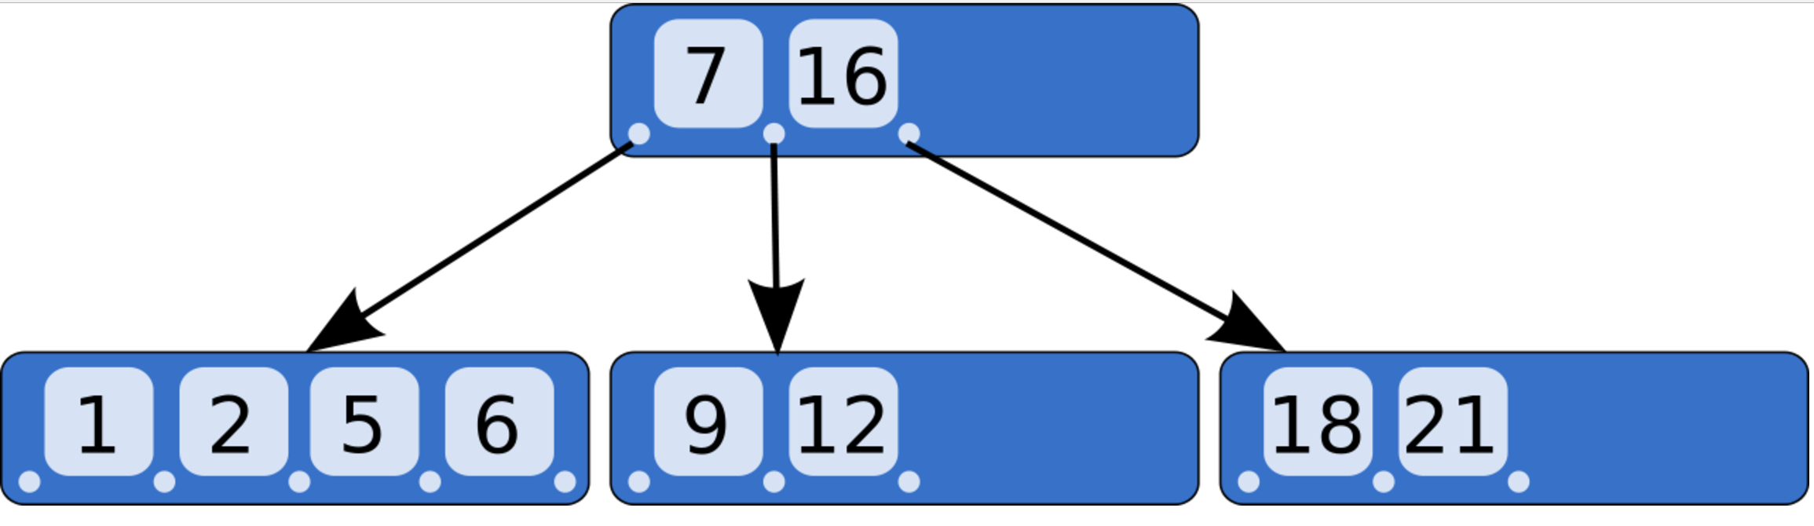
B Tree – Definition
A generalization of
BST that each node
can have more than
two children
  Number of children is usually bounded by a range (e.g. “2-3 Tree” means the number of children is no less than 2, and no more than 3)
  A B Tree of order m
  ➔ max #children of a node = m
  Each node contains a number of keys, which are as separation values dividing its children. A node has at most k children if the tree is of order k+1
  All the leaf nodes must be at the same level

Slide 19
B Tree – Properties
A B-tree of order m is a tree which satisfies the following properties:
  Every node has at most m children.
  Every non-leaf node (except root) has at least ⌈m/2⌉ children.
  The root has at least two children if it is not a leaf node.
  A non-leaf node with k children contains k−1 keys.
  All leaves appear in the same level
The root node’s #children has the same upper limit as internal nodes, but has no lower limit. (why?)
Notes:
Consider a root node with no children.

Slide 20
B Tree – Properties (cont’d)
A B-tree is usually designed to have #keys between (k, 2k)
  #children between (k+1, 2k+1)
  When inserting a key to a node with 2k keys, this node will split into two nodes with k keys and one node with the middle key. This middle key will then be added to its parent.
B Tree is especially useful when the time to access the data greatly exceeds the time to process the data
  e.g. Database, file system ➔ The time to access data from disk is far more than the time to process in memory

Slide 21
B Tree – find()
[Note] Usually in HD, each access fetches a “block” of data, say 100, at once
➔ We can design a B Tree of order 100
[Assume] Each disk block access takes ~10ms, and the time to locate the data in a block can be ignored ➔ find() is O(h)
Given a set with 1M data. Each find() for BST takes log₁₀₀1M * 10ms = 30ms
  If the data are stored in a regular BBST, then it takes log₂1M ~= 20 disk accesses (~10ms each) and 20 comparisons (time can be ignored) ➔ 0.2s

Slide 22
B Tree – insert()
Insert(d)
  Find a leaf node that d should be placed. Insert d and ensure data in the leaf node is ordered
  If no over-float, done, else pick the medium data and insert it to its parent
  Repeat 2 until no over-float. (Note) When the root is split, the height is increased.

Slide 23
B Tree – delete(d)
Locate and remove d in the tree, restructure the tree if needed.
  (For internal node) If d is the separation value for its children, find its successor (from a leaf node) to replace it.
  If a node n has the minimum #keys, find its sibling that can spare a data to perform rotation
  If all other nodes has the minimum #keys, merge n with its neighbor and the separate key in its parent node
  Repeat 2 & 3 until all nodes have more than minimum #keys, or root is reached

Slide 24
Discussion
All operations in a B Tree has O(log_{K}N), where K is the order of the tree
  Assume locating data in a block is relatively fast and its time can be ignored
In practice, insertion and deletion can be slow when it needs to shift/move data in/among blocks
➔ [Solution] Spare some free space in a block for insertion, and mark a node “deleted” instead of remove it from the tree

Slide 25
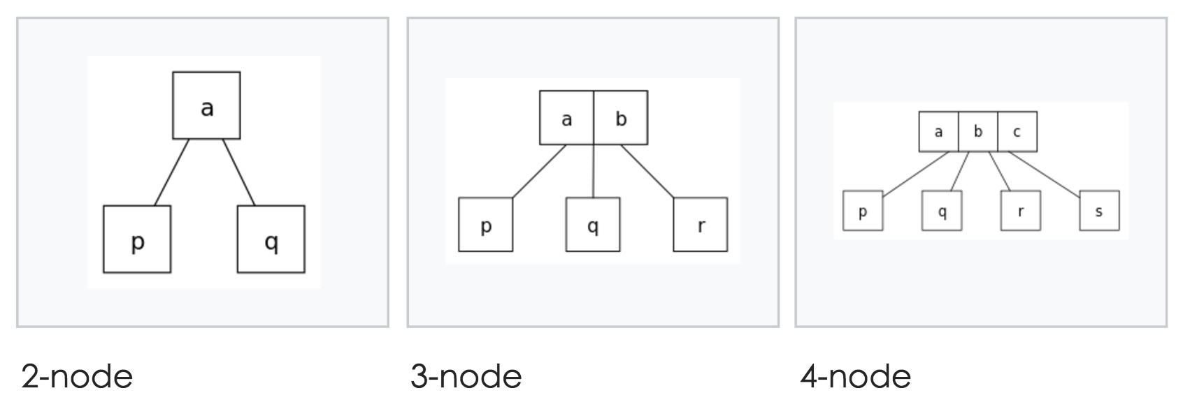
Special B Tree --- 2-3-4 Tree

Slide 26
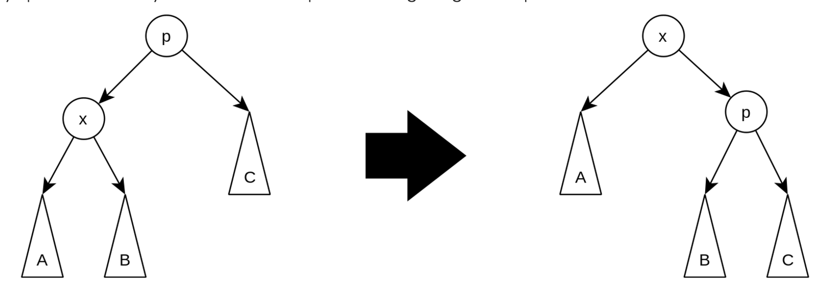
Splay Tree

